Slide 1
AVR Architecture 3 – ATMEGA 328
Dr.Sreejith Rajan

Slide 2
Bitwise operations for I/O
OUTPUT
Make the required DDRx register value 1
Command : DDRB |= (1 << DDB5);
// DDRB5 = 1 ; This means DDRB=DDRB | (1<< DDB5)
Make the required PORTx value 1
Command : PORTB |= (1<<PORTB5)

Slide 3
Continued
Let’s write a Blink code using bitwise operation
0
1

Slide 4
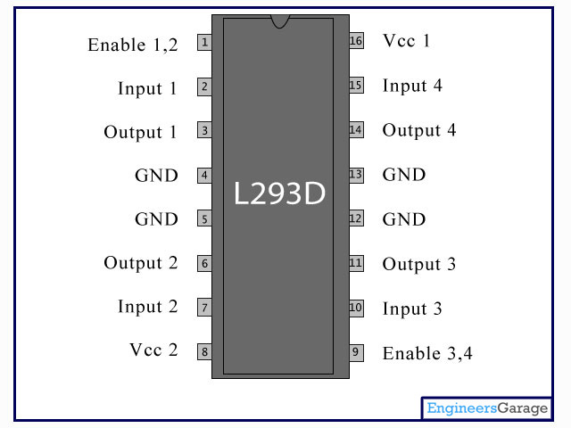
L 293 D –DC Motor driver
0

Slide 5
Rotate a DC motor
Lets code again
0
1

Slide 6
THANK YOU

